Slide 1



Human Computer Interaction: TUIO

Slide 2
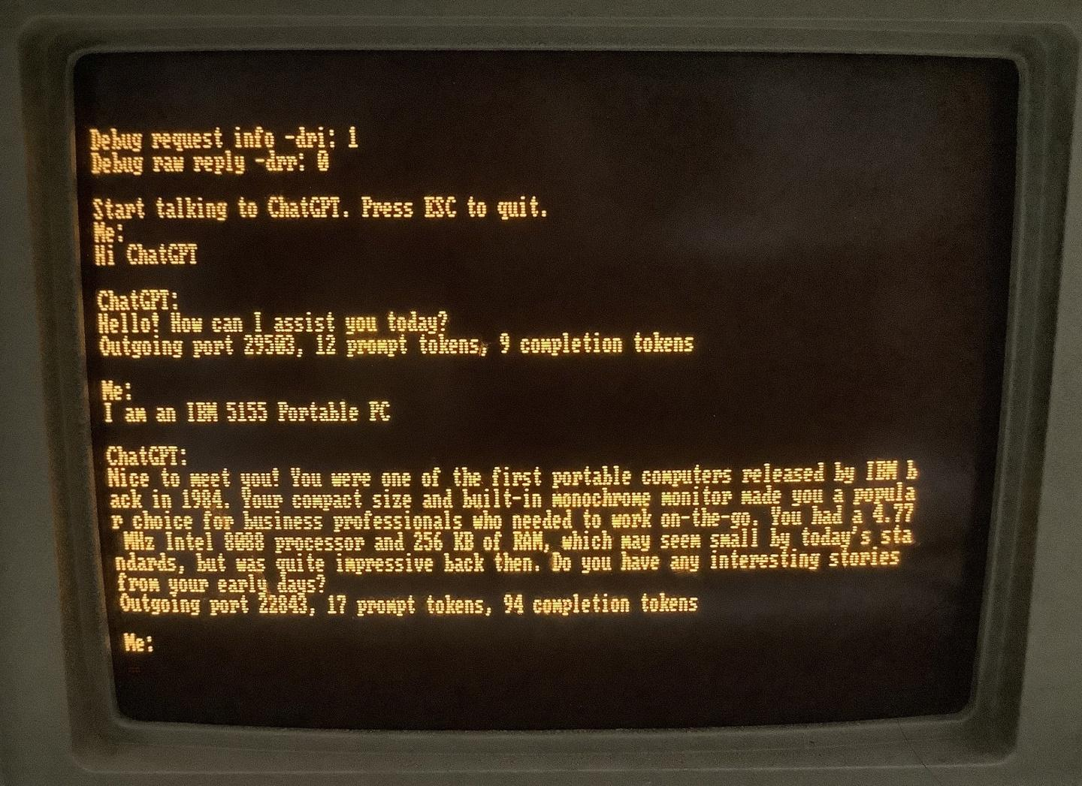
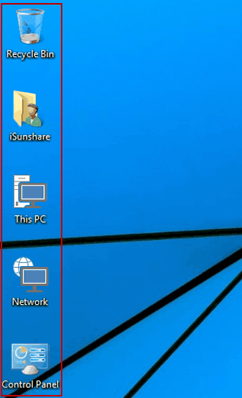
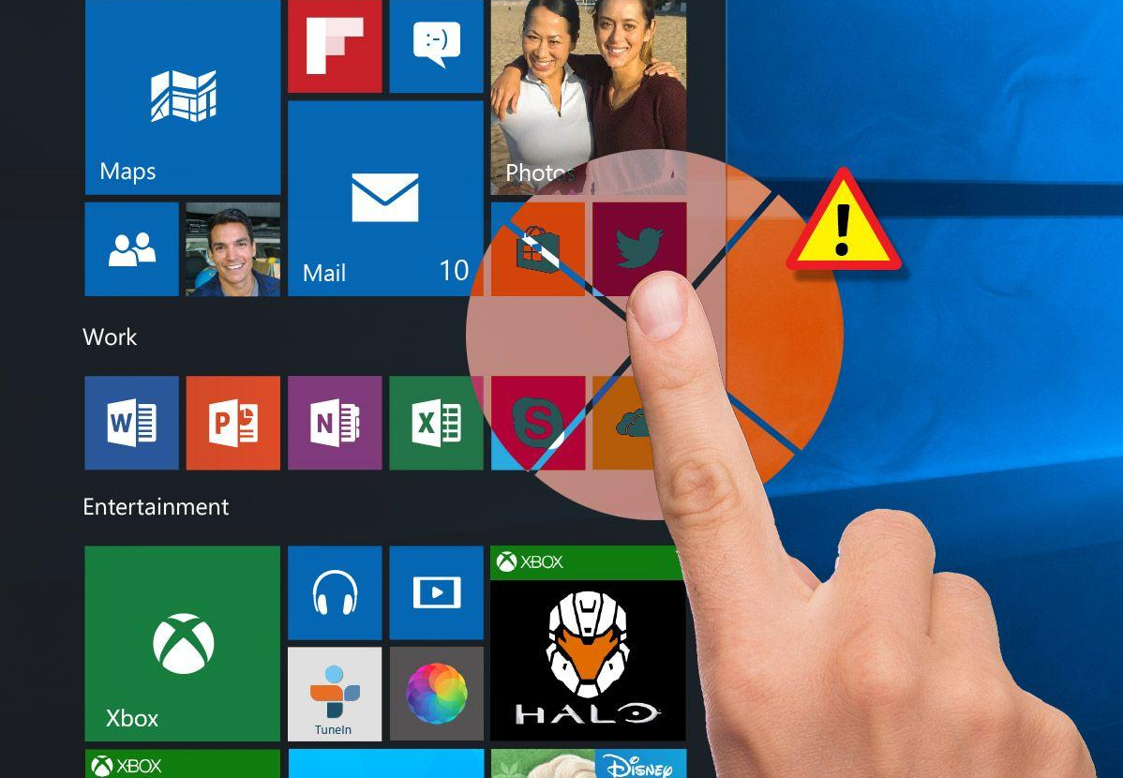

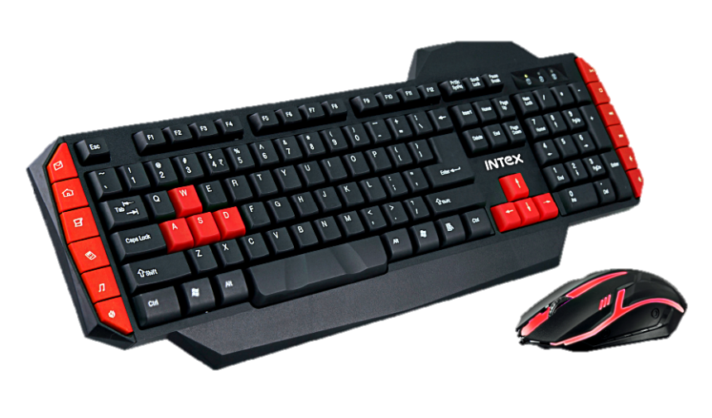
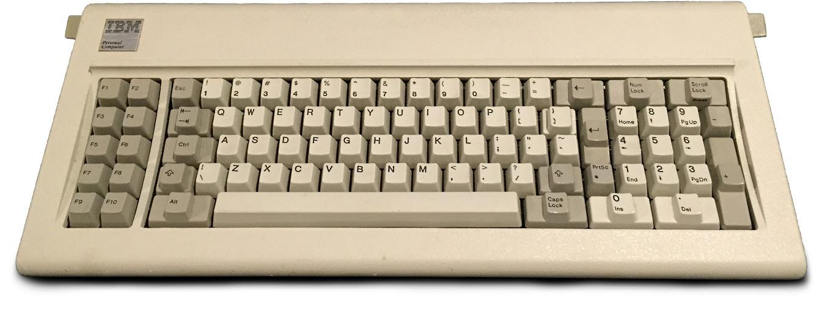
Why HCI

Slide 3


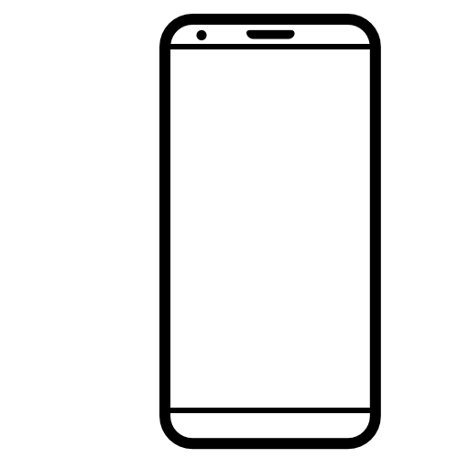
How Many Types of Interactions ?
Human – Human
Computer – Computer
Human – Computer
Computer – Human

Slide 4

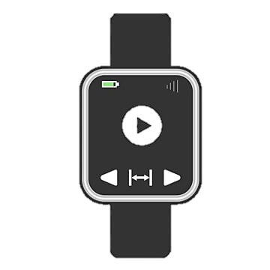
Interactions

Slide 5
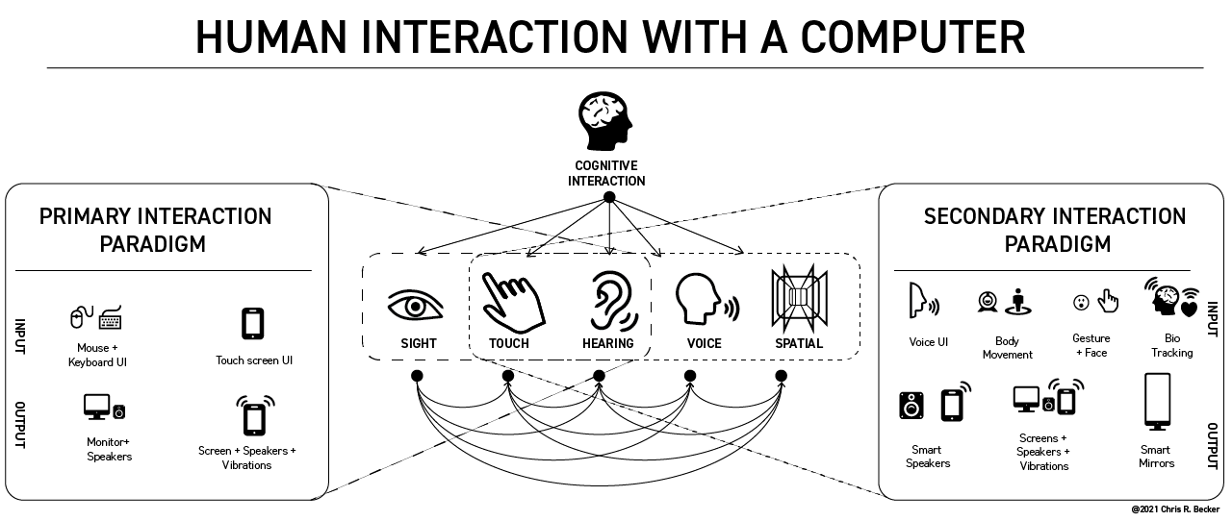

Slide 6
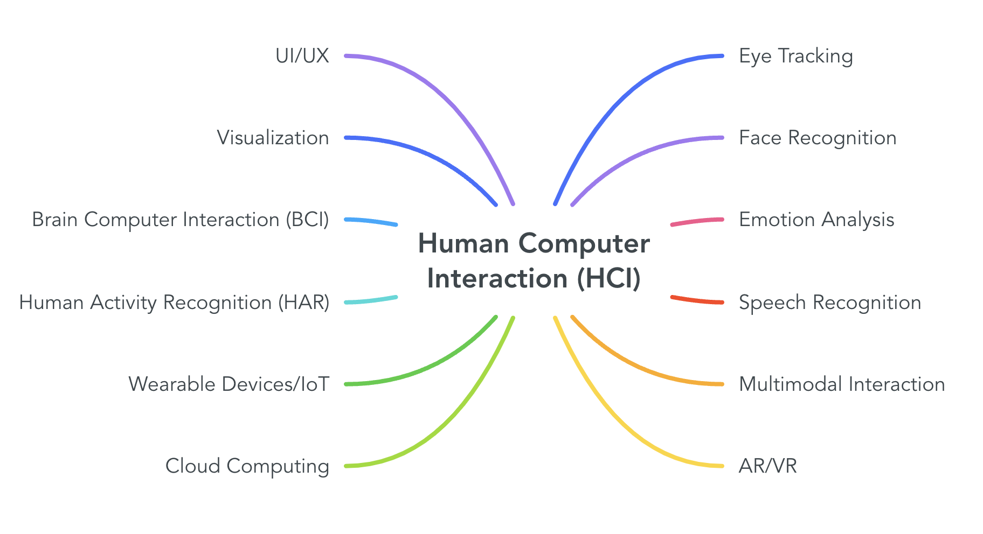
What are the sub-categories of HCI ?
✅
✅
✅
✅
✅
⏳
✅

Slide 7

General Guidelines
Lab is organized as following :
5~10 Minutes intro and history
5 minutes objectives and demos
5~10 minutes discussions
50 minutes for implementation
Attendance is a MUST.
Avoid Being Late.

Slide 8

General Guidelines
Project (25)
Phase I (10)
Phase II (15)
Lab Participation (5)
Quizzes (10)
Extras:
Kahoot
Paper submission will also be considered

Slide 9
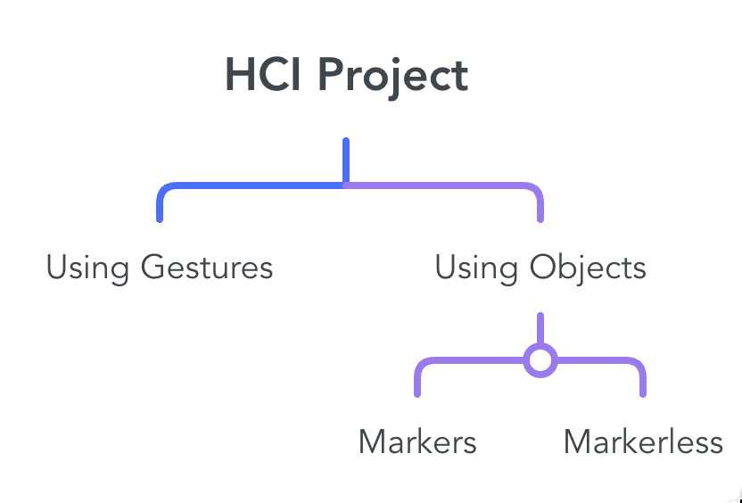
Project
Compare 3 different Interaction Techniques.
Evalute the techniques based on:
User Satisifaction
Engagement
Usability
Surveys

Slide 10
Project
Project is delivered on FOUR phases:
Week 4: Phase 1 (Online Demo)
Week 6: Phase 2 (On campus Discussion)
Week 9: Phase 3 (Formative)
Week 13: Phase 4 ( On Campus Discussion)

Slide 11




Rewards
Best 2 projects participate in DeepMinds
Best project gets 25 marks
We will dedicate a LinkedIn post for the top project
Members of best 2 projects will receive a recommendation on LinkedIn
You can compete in national competitions with your project
Projects can easily be converted into a scientific paper and have higher chance of acceptance in Journals
Multimodality is booming
Journal publication opens lots of doors abroad

Slide 12
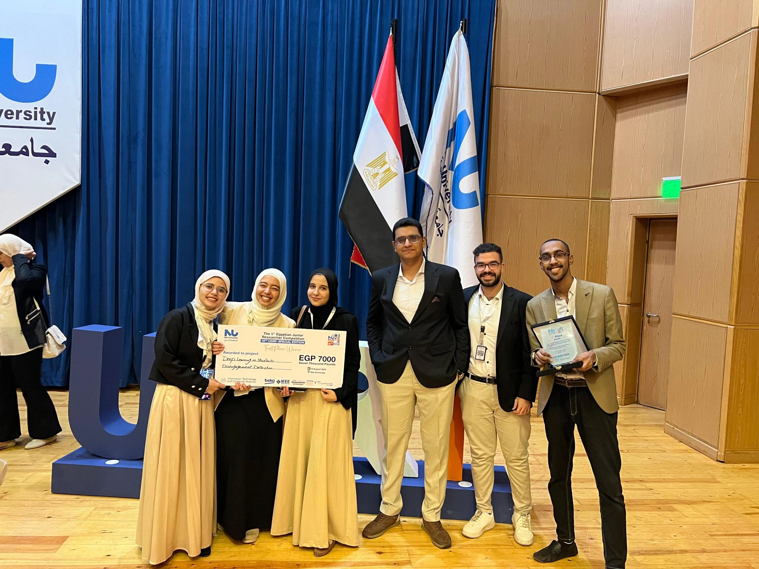
UGRF – CIS: Evaluating Student Engagement

Slide 13
RoadMap
Markers TUIO
Face Detection and Facial Recognition
Week 1
Week 6
TUIO + GUI
Object Detection YOLO
Quiz
Week 2
Week 9
Quiz
Sockets
Emotion + Gaze Tracking
Week 3
Week 10
Bluetooth + Context Awareness
Unity
Quiz
Week 4
Week 11
Quiz
Mediapipe + Gesture Recognition
AR
Week 5
Week 12

Slide 14









Softwares

Slide 15

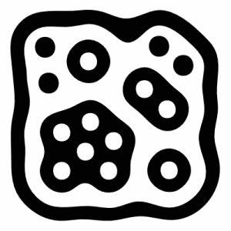
Content : Markers
ArUco
TUIO

Slide 16
Critical Thinking
What is the problem ?
What are the proposed solutions ?
How to implement these solutions ?

Slide 17
Markers
What is markers ?
Why not using QR codes ?
Markers can capture the orientation
Markers vs Markerless

Slide 18
Content : Markers
ArUco
TUIO
Can generate any number of markers
Integrated into openCV
More Difficult to implement
Limited number of markers
Not integrated in OpenCV
Easier to implment
Readymade code is avaiable

Slide 19
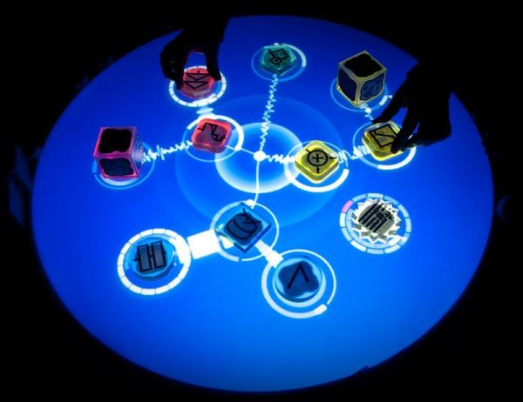
TUIO
Usage
Tangible Child Education
Tangible Games
Tangible Music Player
Notes:
https://realpython.com/python-sockets/

Slide 20
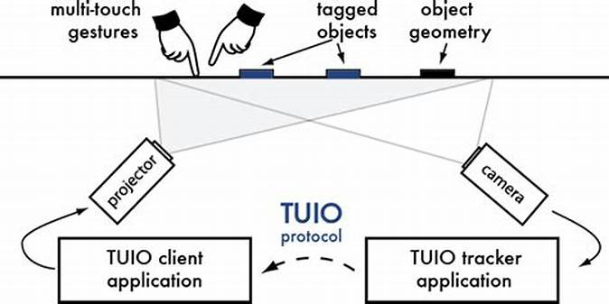
TUIO Setup

Slide 21


TUIO Architecture
Using Sockets
ReacTVIsion Server
Java Client

Slide 22
Where to modify our codes ?
Server is a black box
We edit our codes in the client app
Clients apps are avaible in C++ , Java and C#
No Python client
Inside Java (TUIO Demo Object) we update the function (paint)

Slide 23
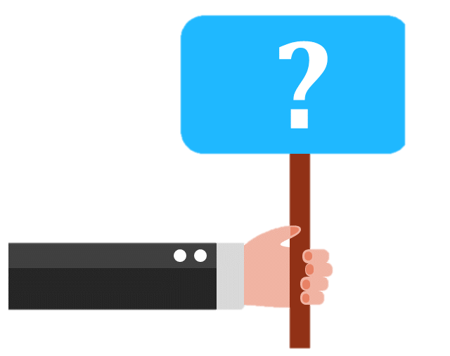
Do You Have Any Question ?
Email
fdarwish@msa.edu.eg
maashraf@msa.edu.eg
akamaleldin@msa.edu.eg
maabdelfattah@msa.edu.eg

